Slide 1

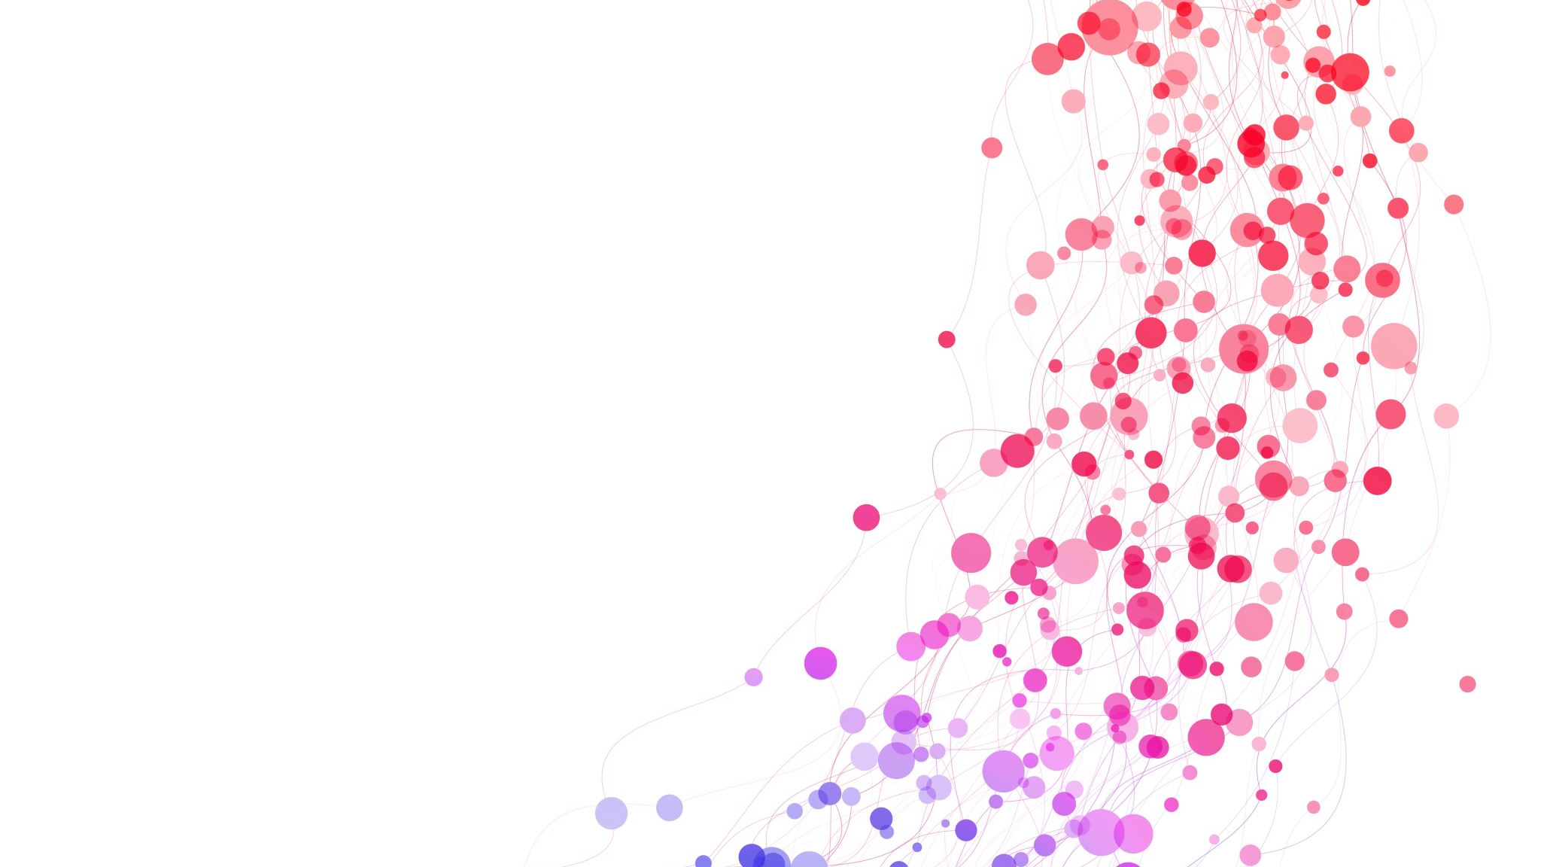
Sea-Hawks AI
Solution starts here!

Slide 2
What is it?
This is a question answering web application which allows users to ask questions based on content of a text document file, the doc file is stored in the backend of the application. The application uses OpenAI's GPT 3.5 model to evaluate the document and provide the best answers to the users.

Slide 3
How does it work?
The backend of the application can work with large data/information given into a text file. This information can be of small businesses who wants to scale up their sales, find out how/where they are losing money, where they could improve, and more. With the help of this web app they can now integrate Artificial intelligence into their business.

Slide 4
Sea-Hawks AI
For now, we selected a text file which contains data/information about reviews/advices/general information for mun courses and semesters. Once a student goes on the website and asks a question about mun courses, any advices, any general info, the web app will provide the answer by evaluating the text doc file with OpenAI's GPT 3.5.

Slide 5
Cost of using OpenAI
So, what is the cost of using OpenAI's GPT model. OpenAI charges $0.0200 per 1000 tokens. 1000 tokens is approximately equivalent to 750 words. So, if a user uses 500 tokens per question, and there are 500 questions every week, total tokens
= 500*500 = 250000. Total cost = 250000/1000 *$0.0200 = $5, so in a month that's $20. Price of a Door-dash order, not bad. To
pay the $20 a month, we could try Google AdSense, or charge 1 coffee ($3.99) from every user for a month.

Slide 6
Solution starts here!
Basically, this would be one stope solutions for students to get quick responses for their questions.

